Slide 1

RAVILLA VAMSI KRISHNA
KEYLOGGER & SECURITY
FINAL PROJECT

Slide 2

KEYLOGGER & SECURITY
Keyloggers are tools designed to record every keystroke made on a computer, often used for malicious purposes such as stealing passwords and sensitive data. The increasing prevalence of keyloggers poses significant security threats to individuals and organizations. This project aims to develop a solution to detect and prevent keyloggers, ensuring enhanced protection and real-time monitoring of keystrokes. Effective security measures are essential to safeguard personal and corporate information from unauthorized access and data breaches.

Slide 3

AGENDA
Problem Statement
Project Overview
Who Are The End Users
Solutions and Value Proposition
The Wow Factor in Our Solution
Modelling
Results

Slide 4
Problem Statement
Increasing Threat: Keyloggers are increasingly being used in cyber-attacks to steal sensitive information, including passwords, financial data, and personal details.
Detection Difficulty: Keyloggers often operate stealthily, making them difficult to detect with traditional security measures.
Security Vulnerability: Both individuals and organizations are at risk of significant data breaches, leading to identity theft, financial loss, and reputational damage.
Need for Real-Time Solutions: There is a critical need for real-time detection and prevention mechanisms to protect against keylogging threats and ensure data security.

Slide 5

Project Overview
Objective: Develop a keylogger detection and prevention system to enhance cybersecurity measures.
Components:
Implement a Python-based keylogger to capture and log keystrokes.
Integrate real-time monitoring to detect and alert on suspicious activities.
Develop a user-friendly interface for easy control and monitoring of keylogging activities.
Securely save keystrokes in both text and JSON formats for analysis and review.

Slide 6
Approach:
Utilize behavioral analysis and machine learning techniques to identify keylogger behavior.
Implement algorithms to distinguish between normal and suspicious keystroke patterns.
Ensure minimal impact on system performance while maintaining high detection accuracy.
Provide users with tools to manage and mitigate keylogger threats effectively.
Outcome:
Enhance overall cybersecurity by providing proactive detection and prevention of keylogger attacks.
Empower users to protect sensitive information and maintain data privacy.
Support both individual and organizational security needs against evolving cyber threats.
Improve user awareness and understanding of keylogger risks and mitigation strategies.

Slide 7
Who Are The End Users
Individuals
Purpose: Protect personal information, such as passwords and private communications.
Benefit: Safeguard against identity theft and unauthorized access.
Businesses
Purpose: Secure corporate data, including intellectual property and financial records.
Benefit: Mitigate risks of data breaches and maintain client trust.
IT Professionals
Purpose: Enhance security within organizational networks and systems.
Benefit: Implement robust defenses against cyber threats, including keyloggers.
Government Agencies
Purpose: Safeguard national security data and confidential governmental information.
Benefit: Ensure integrity and confidentiality in sensitive communications.

Slide 8

Solution and Value Proposition
Keylogger Detection: Utilize advanced algorithms for real-time detection and prevention of keylogger activities.
User-Friendly Interface: Intuitive GUI for easy management and monitoring of keylogging activities.
Enhanced Security: Protects against unauthorized access and mitigates the risk of data breaches.
Compliance: Helps meet data protection regulations and maintain stakeholder trust.

Slide 9

The Wow Factor In Our Solution
Advanced Detection Algorithms
Utilizes state-of-the-art algorithms for accurate and real-time detection of keylogger activities.
Incorporates behavioral analysis to differentiate between normal user behavior and potential threats.
User-Friendly Interface
Intuitive GUI allows easy monitoring and management of keylogging activities.
Provides real-time alerts and notifications for prompt action against suspicious behavior.
Data Security and Encryption
Ensures secure storage of captured keystrokes with robust encryption methods.
Protects sensitive information from unauthorized access and data breaches.

Slide 10

Modelling
1. Keylogger Implementation
Description: Develop a Python-based keylogger to capture and log keystrokes.
Functionality: Records key press, hold, and release events for analysis.
2. Real-Time Monitoring
Description: Implement continuous monitoring of keystrokes for suspicious patterns.
Techniques Used: Behavioral analysis and machine learning models to detect anomalies.
3. Data Storage and Analysis
Description: Store captured keystrokes in both text and JSON formats.
Purpose: Facilitate detailed analysis and review of logged data for threat identification.
4. Alert System
Description: Provide real-time alerts for suspicious keylogging activities.
Integration: Notify users through GUI notifications or email alerts for immediate action.

Slide 11
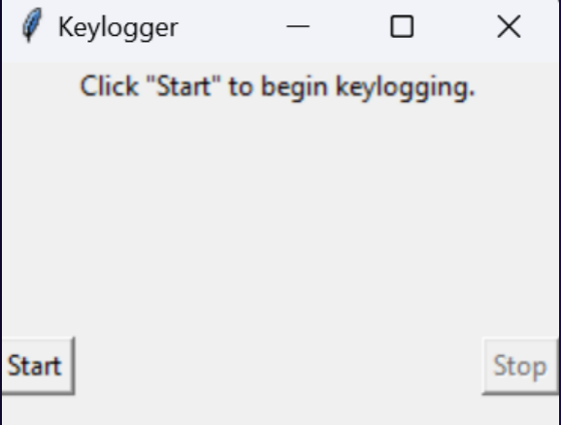
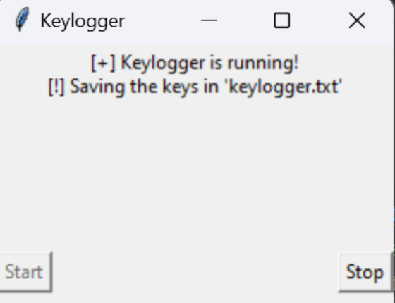
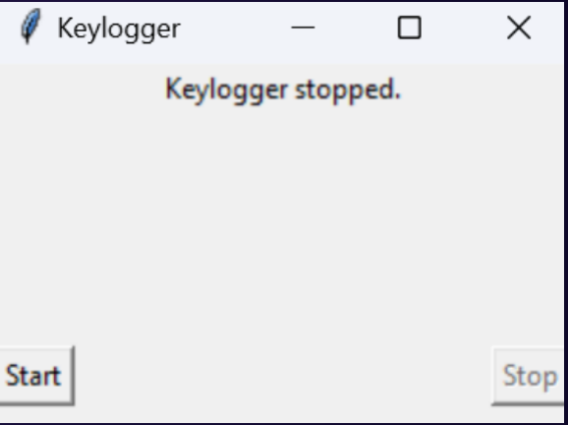
Result
Efficient Keystroke Logging: Successfully logged keystrokes including press, hold, and release events.
Data Storage: Saved keystrokes in both text and JSON formats for comprehensive analysis.
User Interaction: Provided a user-friendly interface with start and stop buttons for easy control of the keylogging process.

Slide 12
Project Link:--
https://github.com/VamsiKrishna308/KeyLogger.git

